Slide 1
Implementation and Analysis of a Machine Learning Approach to long-term Value Investing
Minimize Risk while Maximizing Cash Flow through Stock Picking Based on Fundamental Company Data
Daniel Netzl 20/1/0855/011
Bachelor Exposé

Slide 2
Outline
Motivation
State of the art
Background
Model
Experimental Setup
Evaluation Plan
Conclusion

Slide 3
Motivation
Numerous tactics for long-term success frequently fail
Risk is often underestimated
Self-proclaimed „gurus“ give financial recommendations
Generation Z naively fall prey to Wall Street’s fads
Objectives:
Create an algorithm that aids in the making of sound financial decisions by predicting the intrinsic value of a company
Outperform the benchmark index Vanguard FTSE All-World High Dividend Yield Index

Slide 4
State of the art
Very little research has been done
Popular research is based on high-frequency trading
Amel-Zadeh et al.[1] explored machine learning algorithms based on financial statement data
Neural Networks and Random Forest are benchmarked to OLS linear and Lasso regression
[1] A. Amel-Zadeh, J.-P. Calliess, D. Kaiser, and S. Roberts, “Machine learningbased financial statement analysis.” University of Oxford, 2020. [Online]. Available: https://papers.ssrn.com/sol3/papers.cfm?abstract_id=3520684

Slide 5
Background
Machine Learning models are trained to understand relation between given features and analytic calculations of the intrinsic value
Analytical calculations used are Discounted Cashflow (DCF), Benjamin Graham Stock Valuation Formula & Earnings Power Value (EPV)
Output of the algorithm is one of three signals: “Buy”, “Hold”, “Sell”

Slide 6
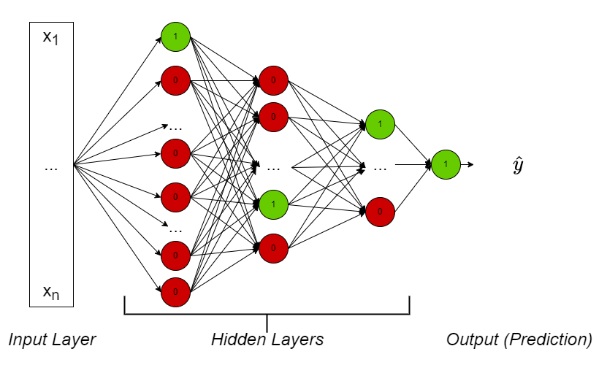
Models
Basic Neural Network structure to fit a sequence of linear functions together with some non-linearity (activation function) to the input features
Random Forest for regression to predict intrinsic value
Less complex OLS and Lasso linear regressions to compare results and check justifiability of complex models

Slide 7
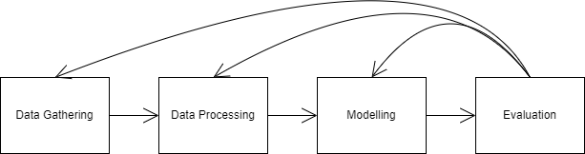
Experimental Setup
Data Ingestion from online APIs YahooFinance & Finviz.com
Explore reliable and consistant sources for qualitative company data
Feature selection and engineering
Process data to fit the models
Fit the models
Evaluate models
Adjust data/models accordingly (based on CRISP-DM)

Slide 8

Evaluation Plan
One-year sliding window to create training and test samples
Simulate trades of proposed undervalued stocks
Calculate returns inside each sliding window and after whole period of holding the stock
Compare returns of selected stocks to benchmark index
Early stopping if signal changes to “Sell”

Slide 9
Conclusion
Goal is to establish an automated method of investing defensively and accurately identify inexpensive equities
Machine Learning models are used to uncover fairly valued companies
Research might be ground-breaking in the field of automated value investing
Job is regarded difficult to complete
Hope for acceptable outcomes, to attract attention and serve as foundation for future research

